Slide 1
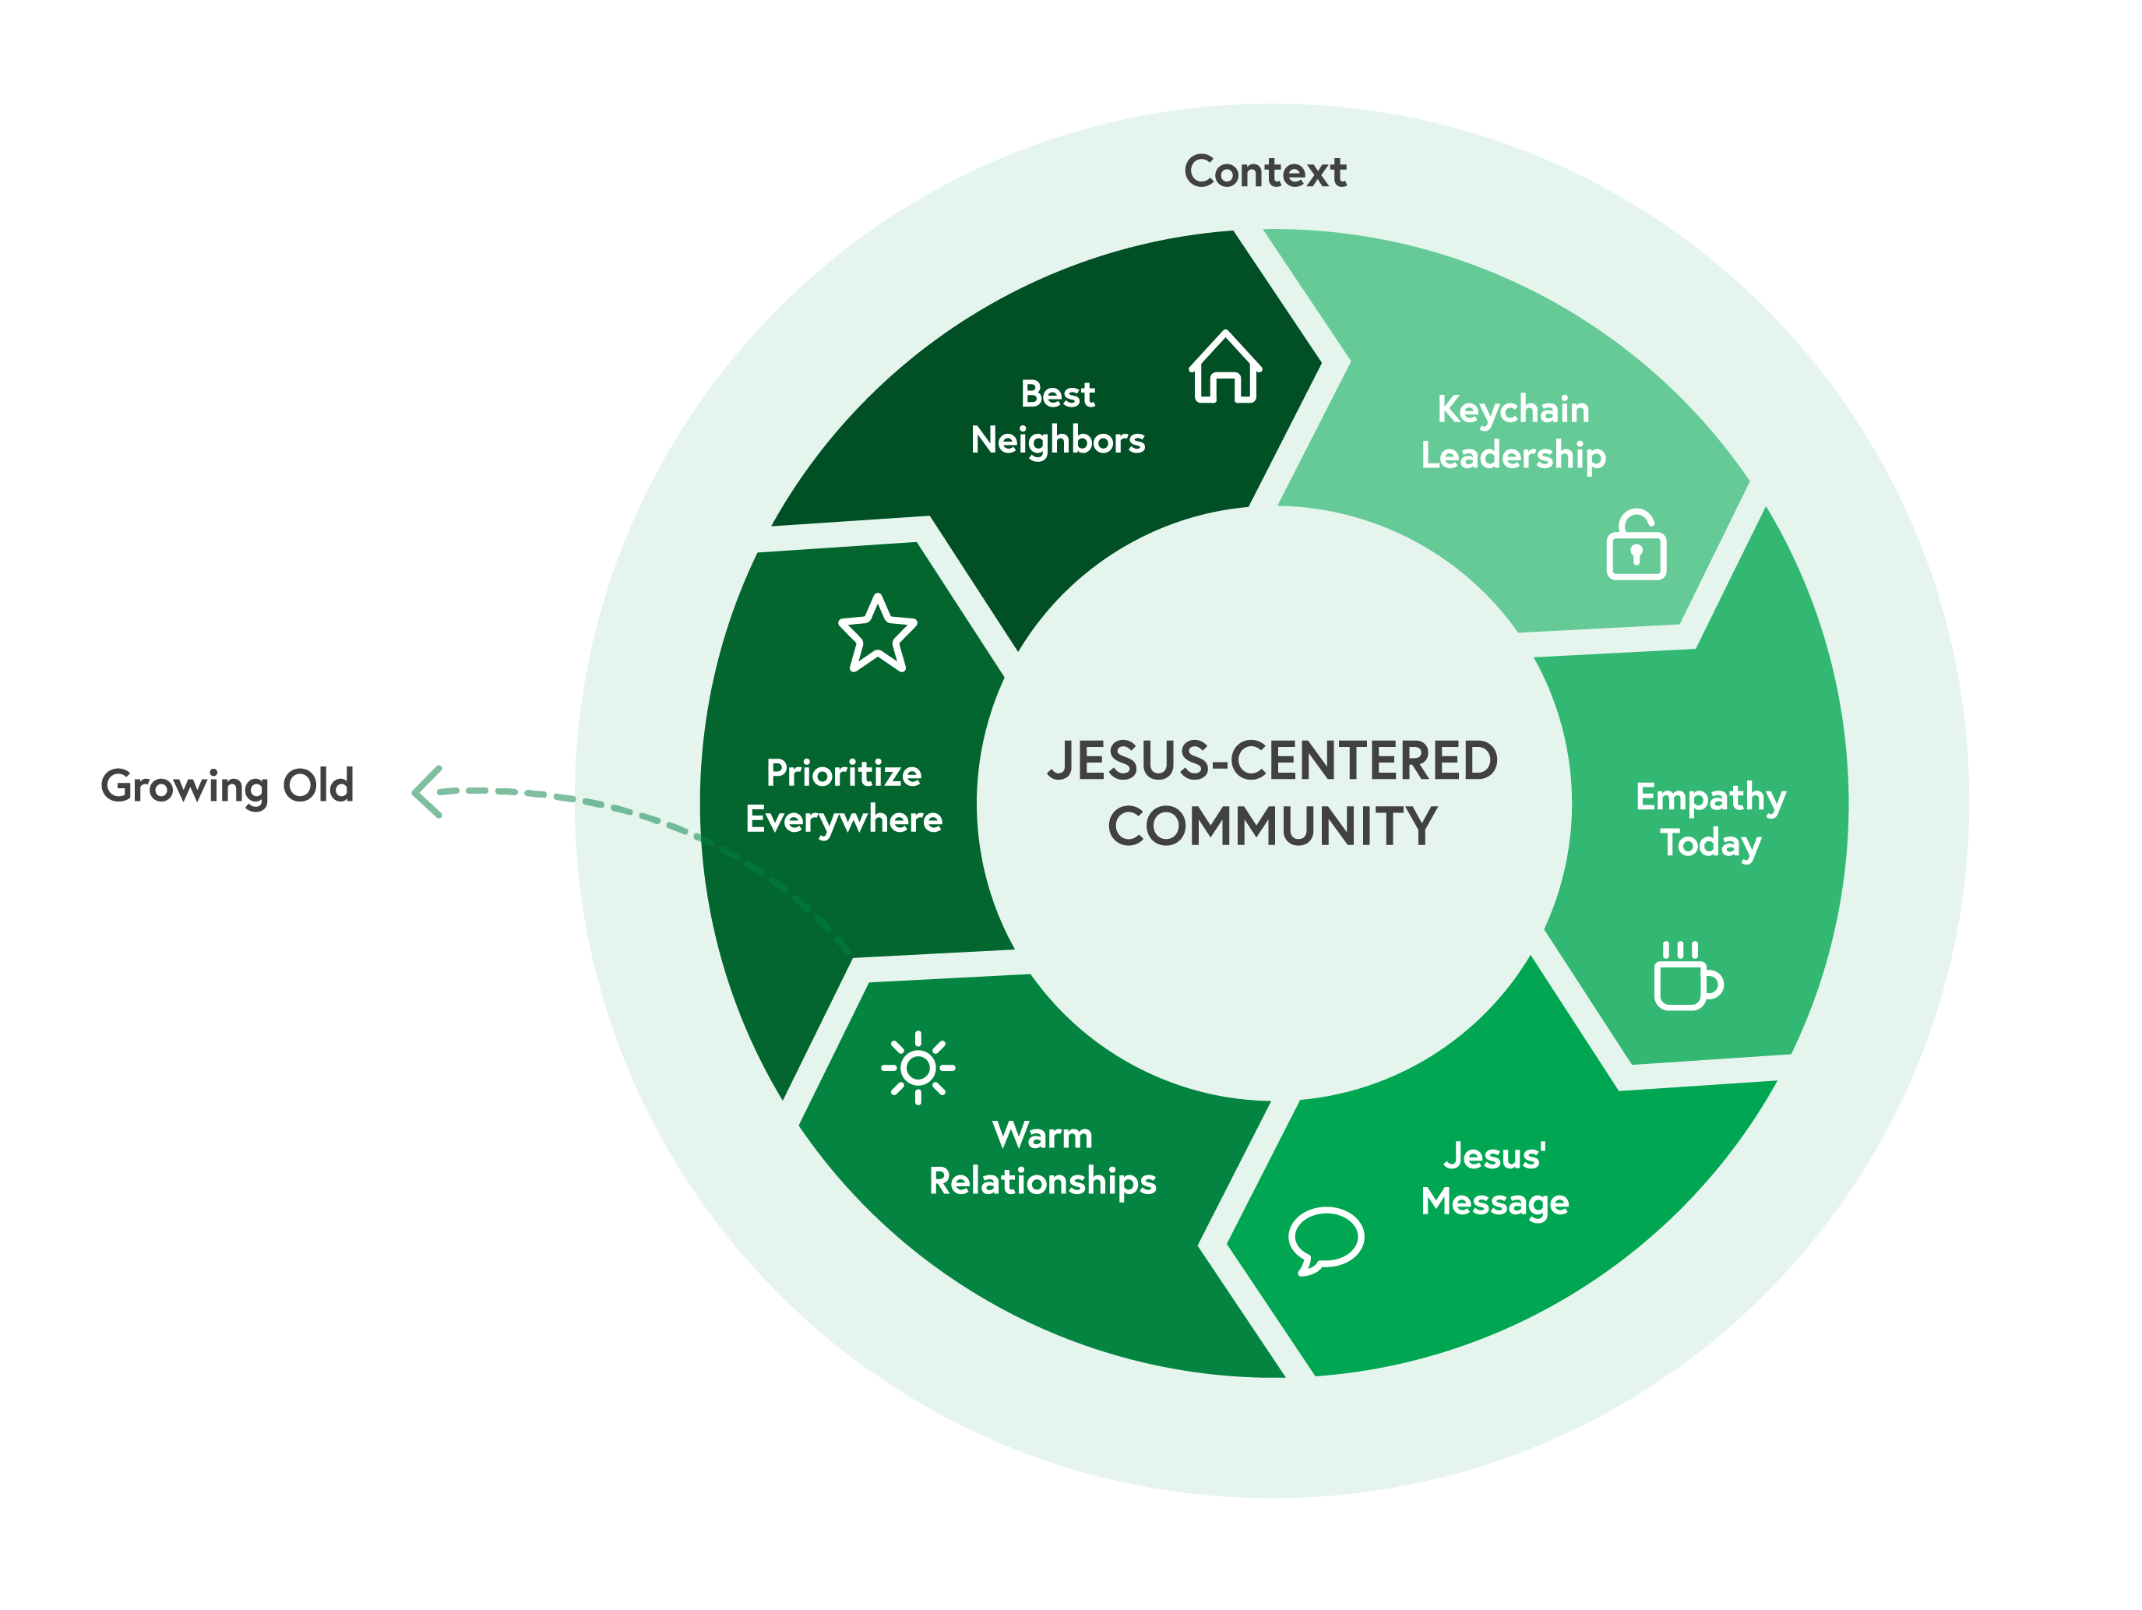
Growing Young: Chapter 5 Fuel a Warm Community

Slide 2
Warm is the new cool!

Slide 3
Personal Relationships = Involvement for
19-23 year olds.

Slide 4
The DNA of a church family is its warmth.

Slide 5
Ideas for Action:
Take Your Congregation’s Relational Temperature
Help Newcomers Land Smoothly and Soon
Create a 5:1 Ratio of Adults to Young People
Multigenerational Worship
Family Room Worship
Tiny Churches
On-ramps
Support Graduates
WARMTH CAN BE SLOW

