Slide 1
Leadership in changing times:
Christian ministry in a time of adaptive change
Theoasis 2017
Bishop Andy Taylor

Slide 2
Case Studies:
Look at case studies in handout on tables.
In teams of 2 or 3, pick a case study to discuss.

Slide 3
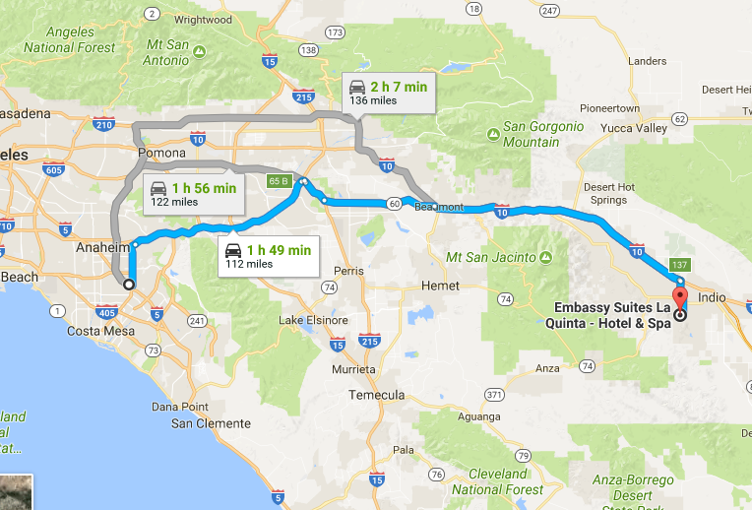
Techinical vs adaptive change:
Technical Change:
Transformation not needed
Tweaking is necessary
Old Rules still apply

Slide 4
Techinical vs adaptive change:
Adaptive Change:
Transformation needed
New ways of thinking necessary
Old Rules no longer apply

Slide 5
Reasons for adaptive change: It’s Time!
Great Emergences:
Destruction of the Temple 66
Monastery System circa 500
Great Schism of the Church 1054
Reformation 1517
Today ????

Slide 6
Reformation: Authority
Sola Scriptura
Challenges:
Slavery
Women
Divorce
Homosexuality

Slide 7
Reformation: Authority
Today’s Question:
Not “What does the Bible Say?” but “Is the Bible an Authority at all?”

Slide 8
The Horrible Decade: 2001-2010
September 11, 2001
Catholic Sex Abuse Scandal 2002
Ordination of Bishop Robinson 2003
Evangelical Political Clout 2004
Economic Recession 2008

Slide 9
Postmodernism
Modernism: Characterized by the belief that an objective reality existed that could be understood by all if the proper tools were used.

Slide 10
Postmodernism
Postmodernism: No such thing as one unified objective reality.
Reality defined by individual perspectives. Hermeneutics, interpretation of reality, is what matters.

Slide 11
What does this mean for Christian leadership?
How Do We Lead a Time of Adaptive Change under These Conditions?

Slide 12
Change
In order to make change, you have to have change.
When you are out of change, you are done.

Slide 13
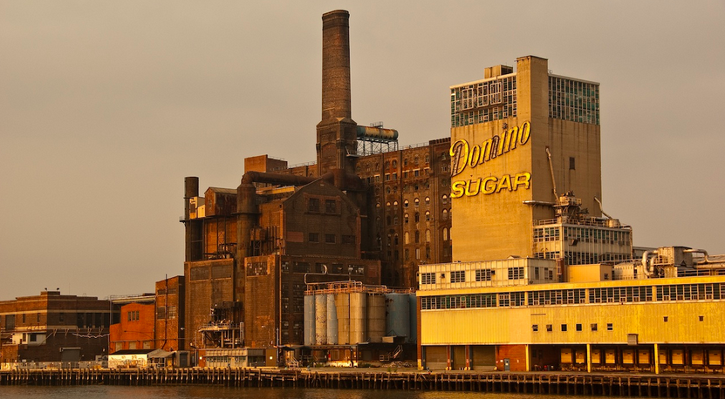
PostModern Frames for leadership: Structural frame
Metaphor: Factory
Central Concepts: Roles, goals, policies, technology, environment
Image of leadership: Social architecture
Basic Leadership Challenge: Attune structures of task, technology, environment

Slide 14
PostModern Frames for leadership: Human Resource Frame
Metaphor: Family
Central Concepts: Needs, skills, relationships
Image of leadership: Empowerment
Basic Leadership Challenge: Align organizational and human needs

Slide 15
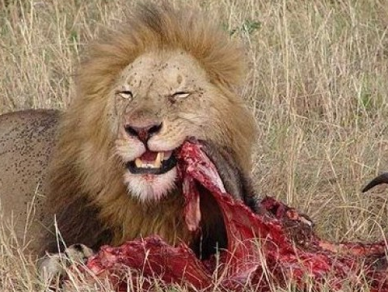
PostModern Frames for leadership: Political Frame
Metaphor: Jungle
Central Concepts: Power, conflict, competition, politics
Image of leadership: Advocacy and political savvy
Basic Leadership Challenge: Develop agenda and power base

Slide 16
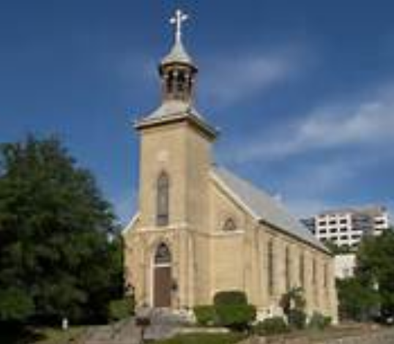
PostModern Frames for leadership: Symbolic frame
Metaphor: Temple, Theater, Carnival
Central Concepts: Culture, meaning, metaphor, ritual, ceremony, stories, heroes
Image of leadership: Inspiration
Basic Leadership Challenge: Create faith, beauty, meaning

Slide 17
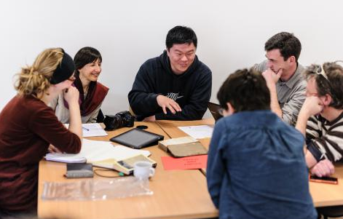
PostModern Frames for leadership: Discussion
Which Leadership Frame: Structural, Human Resources, Political, Symbolic, are you most comfortable using in your setting?
Which do you need to use more often? Why?
How will using these frames help you pick up change?

Slide 18
References
For the five “Emergences, “ see Tickle, Phyllis, The Great Emergence
For the four postmodern leadership frames, see Bolman, Lee and Terrence Deal, Reframing Organizations
For the “Horrible Decade,” see Bass, Diana Butler, Christianity after Religion

